Slide 1
Circadian DEG summary
ZZY
2023. 3. 27

Slide 2
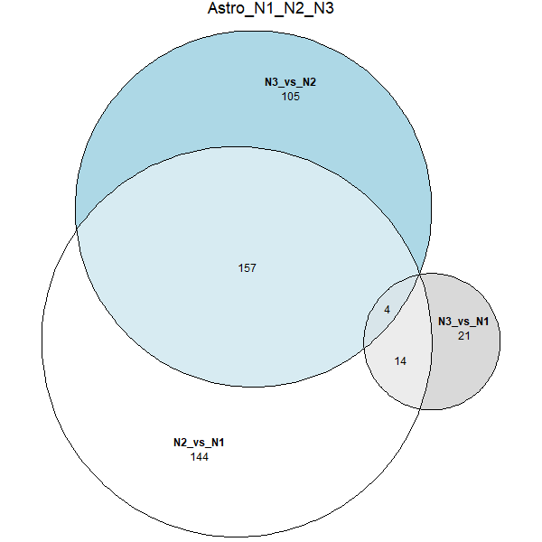
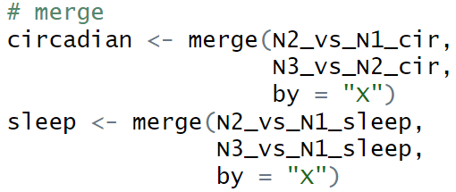
 | sleep | circadian
NS(N1) | Sleep | ZT6
NW(N2) | Wake | ZT18
SD1D(N3) | wake | ZT6
Circadian genes
sleep genes

Slide 3
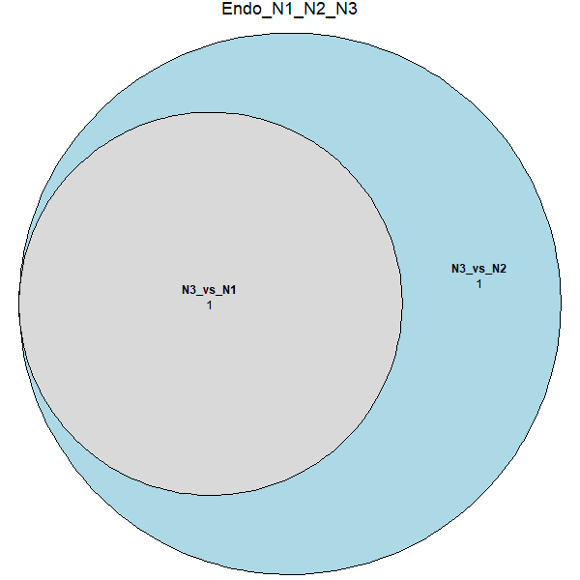
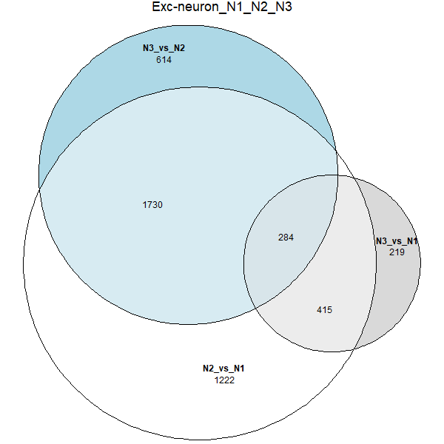
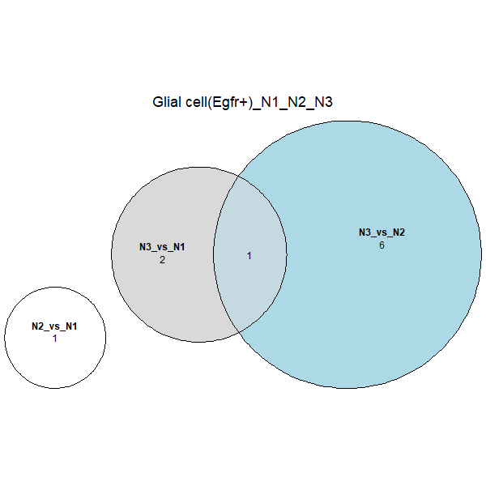
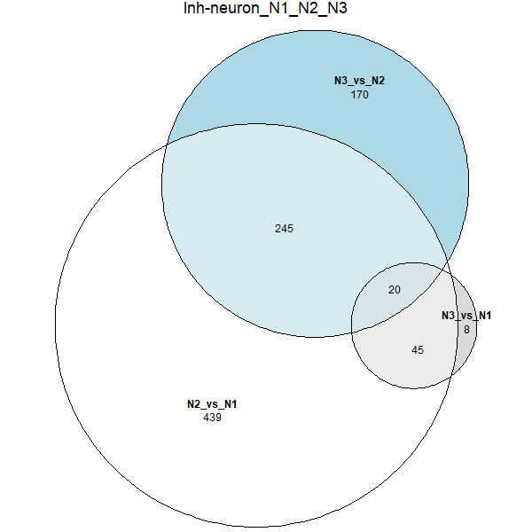
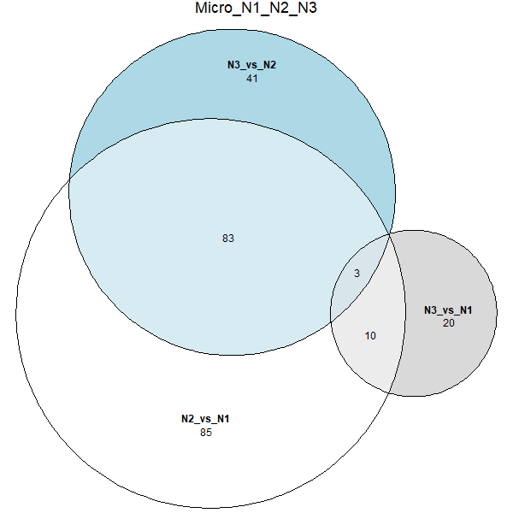
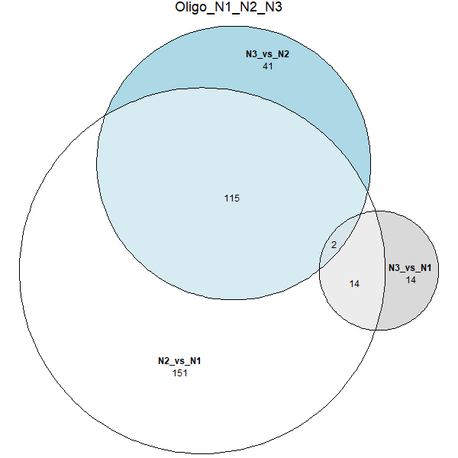
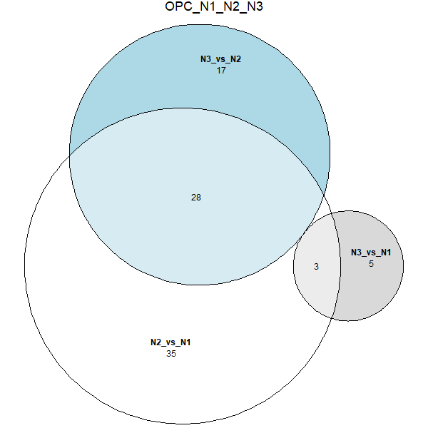
Circadian patterns in each cell type

Slide 4
Circadian DEG number summary
Circadian core genes: overlap in Astro, Exc neuron, Inh neuron, Micro, Oligo, OPC
Total 17
Actb, Basp1, Calm1, Calm2, Dynll1, Egr1, Fth1, Gapdh, Hsp90ab1, Hspa5, Hspa8, Nrgn, Ppia, Stmn1, Tmem267, Tmsb4x, Ubb
 | Astro | Endo | Exc neuron | Glial cell(Egfr+) | Inh neuron | Micro | Oligo | OPC
Total No. | 161 | 0 | 2014 | 0 | 265 | 86 | 117 | 28
Exclusive No. | 30 | / | 1705 | / | 73 | 5 | 19 | 1
Total circadian DEG number(remove repeat): 2149
Notes:
Exclusive: 只在该细胞类型中的DEG

Slide 5
Circadian all DEG hits in circadian databases
Total circadian DEG number(remove repeat): 2149
Total DEG hits: 732
Top 20 hits | Total Hits in databases
Per2 | 29
Hmgb1 | 25
Dbp | 24
Cry1 | 17
Gapdh | 16
Hsp90aa1 | 15
Timp3 | 15
Dnajb6 | 13
Hspa4l | 13
Tuba1b | 12
Acsl1 | 11
Cys1 | 11
Slc25a5 | 11
Hspa8 | 10
Fbn1 | 9
Pdxk | 9
Thra | 9
Calm1 | 8
Anp32a | 8
Calr | 8
Notes:
CIRCA: Circadian gene expression profiles. (hogeneschlab.org)

Slide 6
Circadian core DEG hits in circadian databases
 | found in circadian database
Actb | 6
Basp1 | #N/A
Calm1 | 8
Calm2 | #N/A
Dynll1 | 6
Egr1 | 1
Fth1 | 1
Gapdh | 16
Hsp90ab1 | 3
Hspa5 | 6
Hspa8 | 10
Nrgn | #N/A
Ppia | 2
Stmn1 | #N/A
Tmem267 | #N/A
Tmsb4x | #N/A
Ubb | #N/A
10 hits in 17 DEGs

Slide 7
Circadian cell type specific DEG hits in circadian databases
 | Astro | Endo | Exc neuron | Glial cell(Egfr+) | Inh neuron | Micro | Oligo | OPC
Total No. | 161 | 0 | 2014 | 0 | 265 | 86 | 117 | 28
Hits in Total No. | 69 | / | 690 | / | 91 | 42 | 63 | 18
Exclusive No. | 30 | / | 1705 | / | 73 | 5 | 19 | 1
Hits in Exclusive No. | 11 | / | 573 | / | 20 | 2 | 7 | 0

Slide 8
Circadian Astro specific DEG hits in circadian databases
 | p_val. N2 vs. N1 | avg_log2FC.N2 vs. N1 | pct.1. N2 vs. N1 | pct.2. N2 vs. N1 | p_val_adj. N2 vs. N1 | p_val. N3 vs. N2 | avg_log2FC. N3 vs. N2 | pct.1. N3 vs. N2 | pct.2. N3 vs. N2 | p_val_adj. N3 vs. N2 | hits in circadian databases
Gm26512 | 5.27E-26 | -0.65512 | 0.198 | 0.388 | 1.84E-21 | 1.25E-17 | 0.515872 | 0.335 | 0.198 | 4.35E-13 | #N/A
Gpr158 | 2.19E-20 | -0.64826 | 0.098 | 0.23 | 7.62E-16 | 1.12E-07 | 0.309177 | 0.163 | 0.098 | 0.003894 | #N/A

Slide 9
Circadian Inh neuron specific DEG hits in circadian databases
 | p_val. N2 vs. N1 | avg_log2FC.N2 vs. N1 | pct.1. N2 vs. N1 | pct.2. N2 vs. N1 | p_val_adj. N2 vs. N1 | p_val. N3 vs. N2 | avg_log2FC. N3 vs. N2 | pct.1. N3 vs. N2 | pct.2. N3 vs. N2 | p_val_adj. N3 vs. N2 | hits in circadian databases
Cpa6 | 1.12E-14 | 0.933243 | 0.066 | 0.013 | 3.91E-10 | 1.16E-13 | -0.90701 | 0.015 | 0.066 | 4.03E-09 | #N/A
Meis2 | 4.41E-35 | 1.519472 | 0.259 | 0.097 | 1.54E-30 | 1.28E-44 | -2.15316 | 0.083 | 0.259 | 4.45E-40 | #N/A
Pbx1 | 5.56E-09 | 0.590119 | 0.681 | 0.653 | 0.000194 | 4.59E-11 | -0.7163 | 0.645 | 0.681 | 1.60E-06 | #N/A
Pbx3 | 4.22E-13 | 0.952459 | 0.213 | 0.126 | 1.47E-08 | 3.58E-17 | -1.22287 | 0.112 | 0.213 | 1.25E-12 | #N/A

Slide 10
Circadian Micro specific DEG hits in circadian databases
 | p_val. N2 vs. N1 | avg_log2FC.N2 vs. N1 | pct.1. N2 vs. N1 | pct.2. N2 vs. N1 | p_val_adj. N2 vs. N1 | p_val. N3 vs. N2 | avg_log2FC. N3 vs. N2 | pct.1. N3 vs. N2 | pct.2. N3 vs. N2 | p_val_adj. N3 vs. N2 | hits in circadian databases
Gm13710 | 6.18E-08 | -0.6194 | 0.049 | 0.123 | 0.002155 | 3.84E-08 | 0.578375 | 0.122 | 0.049 | 0.001338 | #N/A

Slide 11
Circadian Oligo specific DEG hits in circadian databases
 | p_val. N2 vs. N1 | avg_log2FC.N2 vs. N1 | pct.1. N2 vs. N1 | pct.2. N2 vs. N1 | p_val_adj. N2 vs. N1 | p_val. N3 vs. N2 | avg_log2FC. N3 vs. N2 | pct.1. N3 vs. N2 | pct.2. N3 vs. N2 | p_val_adj. N3 vs. N2 | hits in circadian databases
ENSMUSG00000120522 | 5.02E-32 | -0.90671 | 0.329 | 0.559 | 1.75E-27 | 1.46E-20 | 0.678181 | 0.52 | 0.329 | 5.09E-16 | #N/A
Kirrel3 | 1.19E-19 | -0.93745 | 0.326 | 0.498 | 4.15E-15 | 6.61E-15 | 0.837596 | 0.471 | 0.326 | 2.31E-10 | #N/A
Pcdh15 | 1.08E-09 | -0.5969 | 0.168 | 0.274 | 3.75E-05 | 6.38E-08 | 0.587758 | 0.263 | 0.168 | 0.002225 | #N/A
Smad7 | 2.62E-12 | -0.68633 | 0.212 | 0.334 | 9.12E-08 | 1.16E-06 | 0.456944 | 0.297 | 0.212 | 0.040374 | #N/A

